Slide 1
Sprint 3 Presentation
Notes:
Good afternoon. We are Team 4: Bara, Ehsanullah, Kyle and Leonard, and our client is Quick Phone Repair, a phone repair business with two stores. In Sprint 3 we moved from analysis into design. We will cover what changed since Sprint 2 and what we fixed after checking our work against the textbook, then walk through the physical data flow diagram and the physical ERD, show three interface prototypes, and finish with our limitations, risks, open decisions and next steps. We will ask for your feedback at the end.

Slide 2
What changed since Sprint 2
Modified logical DFDs naming to reflect what the system does (Record Diagnosis, Record Repair Work, etc.)
Appointment scheduling is in scope, walk-ins skip it.
ERD simplified from 22 to 16 entities
DFDs and ERD aligned: 7 data stores hold the 16 entities, each entity in one data store.
Built physical DFDs & ERDs
Built three new prototypes
Notes:
This slide answers the Sprint 2 feedback point by point. First, process names. The old diagrams named people's work, like Diagnose Device and Repair Device. Every process now names what the system does, such as Record Diagnosis and Record Repair Work. Second, appointments. Scheduling is in scope but optional: it has its own process, 1.0, and its own use case, UC-12, and walk-ins skip it. Third, the ERD was too hard to read, so we cut it from 22 entities to 16 and redrew every diagram at slide size. Fourth, the DFDs and the ERD now line up: seven data stores hold the sixteen entities, and each entity sits in exactly one store. We also added the context diagram you asked for, built the physical DFDs and physical ERD, and built three interface prototypes. And we revised the Sprint 1 System Request and Feasibility Analysis and recorded every change, with its cause, in the Change Log.

Slide 3
What we fixed after the textbook review
Logical ERD in third normal form; derived values kept only in the physical ERD, marked
Every ERD relationship named both ways (employs / is employed by)
Every data flow has a unique name; each Level 1 DFD balances with Level 0
Data flow dictionary for all 165 logical flows (models document, Appendix B)
New use case UC-13 View Repair Status covers FR13 and DFD process 8.0
FR08 (release after payment) marked proposed: our decision, not client-confirmed
Notes:
After building the models, we checked every Sprint 1 to 3 deliverable against the textbook, Dennis, Wixom and Roth, and against your feedback, and fixed what we found. The logical ERD is now in third normal form. Values we can calculate, such as a job's current status and a quote total, are left out of the logical model; the physical model stores them on purpose, for speed, and marks them as derived. Every relationship line on the ERD is now named in both directions, as in the textbook's physical ERD: a store employs employees, and an employee is employed by a store. On the DFDs, every data flow name is now unique, and each Level 1 diagram balances with its Level 0 parent. Appendix B of the models document describes all 165 logical flows and the data each one carries. We added use case UC-13, View Repair Status, because the status report requirement had a process but no use case. And we marked FR08, release only after payment, as proposed, because it is our decision, not something the client has confirmed yet.

Slide 4
Acquisition and technical approach
Criterion | Weight | Custom: Django + PostgreSQL | Repair-shop subscription | Shared spreadsheet
Fit to the confirmed rules | 25 | 125 (5) | 75 (3) | 50 (2)
Access control and record integrity | 15 | 60 (4) | 75 (5) | 15 (1)
One view of both stores | 10 | 50 (5) | 50 (5) | 30 (3)
Annual cost to QuickPhone (est.) | 20 | 80 (4) | 40 (2) | 100 (5)
Support after December 9 | 15 | 30 (2) | 75 (5) | 45 (3)
Delivers the MOU deliverables | 10 | 50 (5) | 20 (2) | 30 (3)
Adoption by staff used to paper | 5 | 20 (4) | 15 (3) | 15 (3)
Total (of 500) | 100 | 415 | 350 | 285
Hardware and software (Ch. 7)
Three-tier thin client–server, hosted offsite (Fig. 7-2)
Browser on counter and bench devices: the existing laptop plus up to 3 more (est. $0–$2,400)
Python 3.12, Django 5.2 LTS (security fixes to April 2028)
PostgreSQL 16+, managed, daily backup (NFR06)
Email through the store’s own mailbox (client #7); one label printer per store (est. $0–$400)
Hosting est. $0–$450 a year
What reverses it: a vendor demo proving full rule fit only narrows the gap (415 vs 400). If nobody will support the system after December 9 (support weighted 30, fit 10), the subscription wins, 380 vs 370. Scores 1–5 in brackets; SAD 8e Fig. 6-6.
Notes:
Our acquisition and technical approach. Using the textbook’s weighted alternative matrix, we compared three routes: building a custom system, subscribing to a product made for repair shops, and a shared spreadsheet. The weights come from what the owner has told us matters. Fit to the seven rules the owner confirmed counts most, then the yearly cost, support after we hand over on December 9, and the deliverables in our MOU. The custom build scores 415 out of 500, the subscription 350 and the spreadsheet 285. Custom wins on fit and on the MOU. The subscription wins on support, but at about 140 to 150 dollars per store per month it costs more than twice our likely yearly estimate. The result is not safe: if the owner cannot name anyone to look after the system after December 9, the subscription comes out ahead, and we will tell the owner so. On the right is the technical approach: a three-tier web application in Python with the Django framework and a PostgreSQL database, hosted offsite and used through a browser on the counter and bench devices. Every cost here is an estimate from our feasibility study, and the choice stays provisional until the owner confirms it.

Slide 5
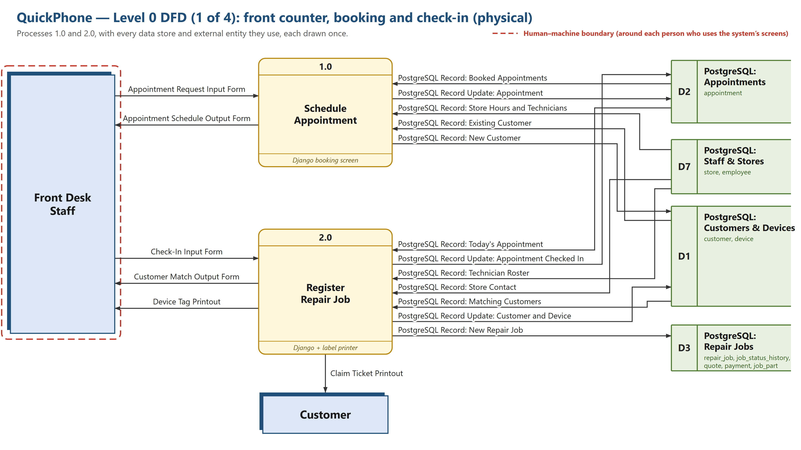
Notes:
This is part 1 of the physical Level 0 DFD, the front counter at booking and check-in: 1.0 Schedule Appointment and 2.0 Register Repair Job. Physical means it shows how each step is carried out. The band at the bottom of each process says how, for example Django and a label printer for check-in. Each data store lists the database tables it holds, and those are the same tables you will see on the ERD. The dashed red line is the human-machine boundary. As in the textbook, it goes around each person who uses the system’s screens, here the Front Desk. The Customer has no line, because they only receive the printed claim ticket and never use the screens. Each line is one data flow, and its name says how the data travels, as in the textbook's physical DFDs: an Input Form is a screen staff fill in, an Output Form is a screen the system shows, the Claim Ticket Printout comes off the label printer and goes to the Customer, and a PostgreSQL Record line reads or writes the tables of the store it touches. The other three Level 0 parts, the complete Level 0, every Level 1 diagram and the logical versions are in the models document, the DFD and ERD slide deck, and the physical DFD set PDF.

Slide 6
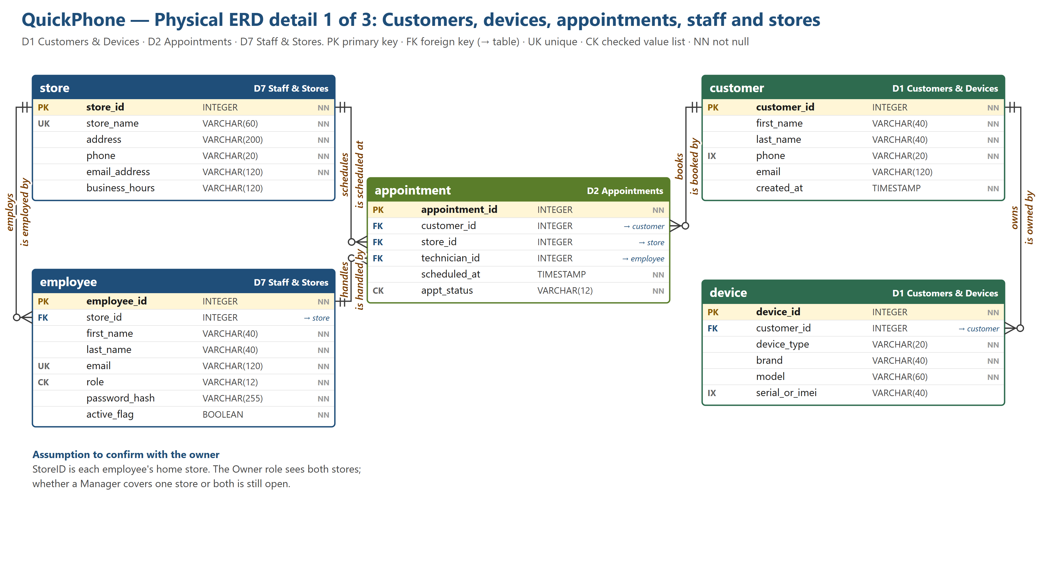
Physical ERD
Notes:
This is the physical ERD, detail 1 of 3: customers, devices, appointments, staff and stores. Each table shows its keys, data types and required columns, and the colored header names the DFD data store that holds it, so you can match it to the data flow diagrams. Each line is named both ways: the first name reads from the one side to the many side, the second reads back. A store employs employees and schedules appointments, a technician handles appointments, and a customer owns devices and books appointments; read back, an employee is employed by a store and an appointment is booked by a customer. The crow's foot marks give cardinality and modality, so a customer can have zero or many devices, and each device belongs to exactly one customer. The note at the bottom is an assumption the owner must confirm: each employee has a home store, and we do not yet know whether a manager covers one store or both.

Slide 7
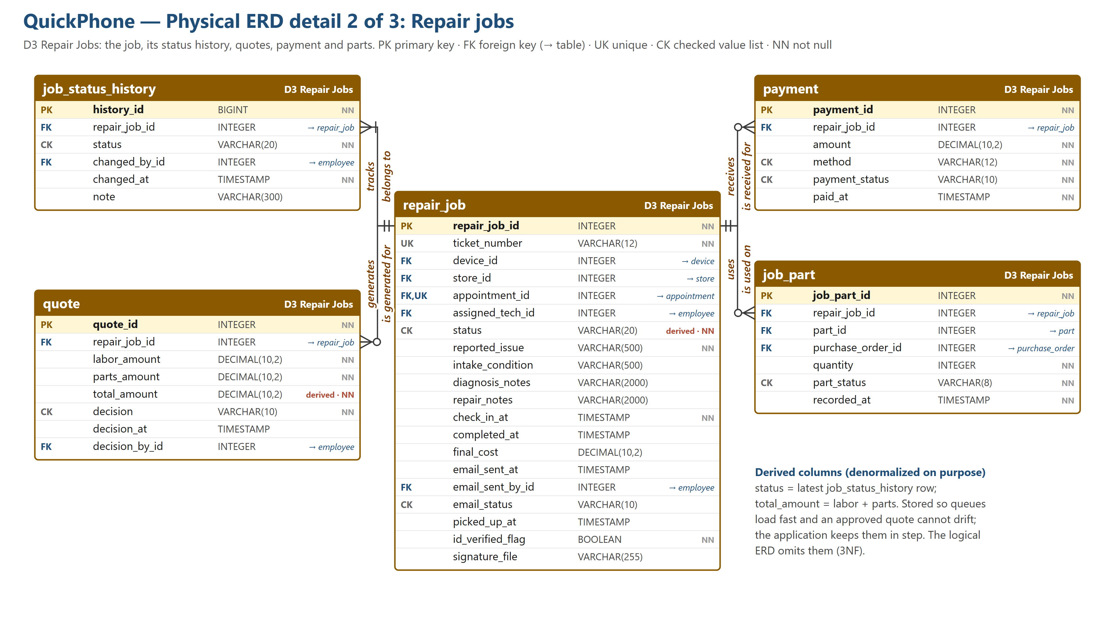
Notes:
Detail 2 is the repair job, the center of the system. A repair job tracks its status history, generates quotes, receives payment and uses parts. The status history always has at least one row, because every job starts as Checked In. Two columns are derived and stored on purpose, and they are marked: the current status, which is the latest history row, and the quote total, which is labor plus parts. We store them so the job queues load quickly and an approved quote cannot change afterwards; the logical ERD leaves them out to stay in third normal form. Columns that point to an employee record who did something, such as who sent the pickup notification or who decided a quote.

Slide 8
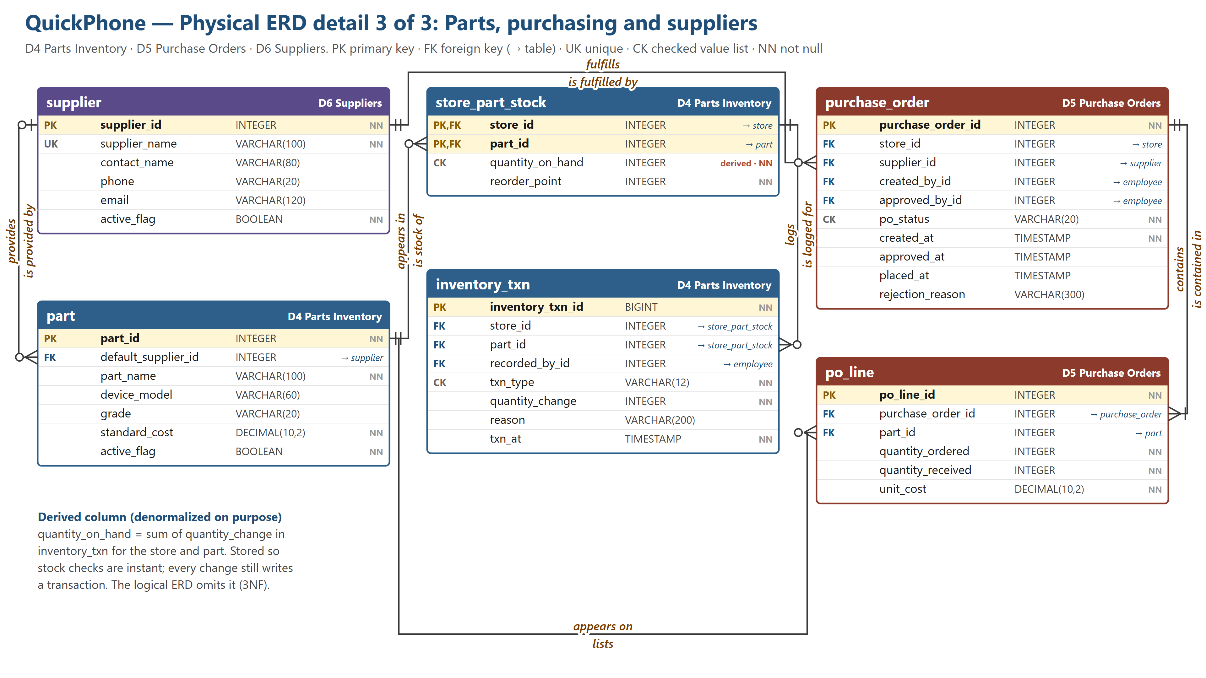
Notes:
Detail 3 covers parts, purchasing and suppliers. A part appears in each store's stock, and every change to that stock is logged as an inventory transaction: a part used, received or adjusted. Quantity on hand is the sum of those transactions; like the status on the last slide, the physical model also stores it so stock checks are instant. A supplier fulfills purchase orders and is the default source for parts. A purchase order contains its lines, and a part can appear on many order lines. Created-by and approved-by link each purchase order to the employees involved, which supports the client's rule that the owner approves every purchase order before it is placed.

Slide 9
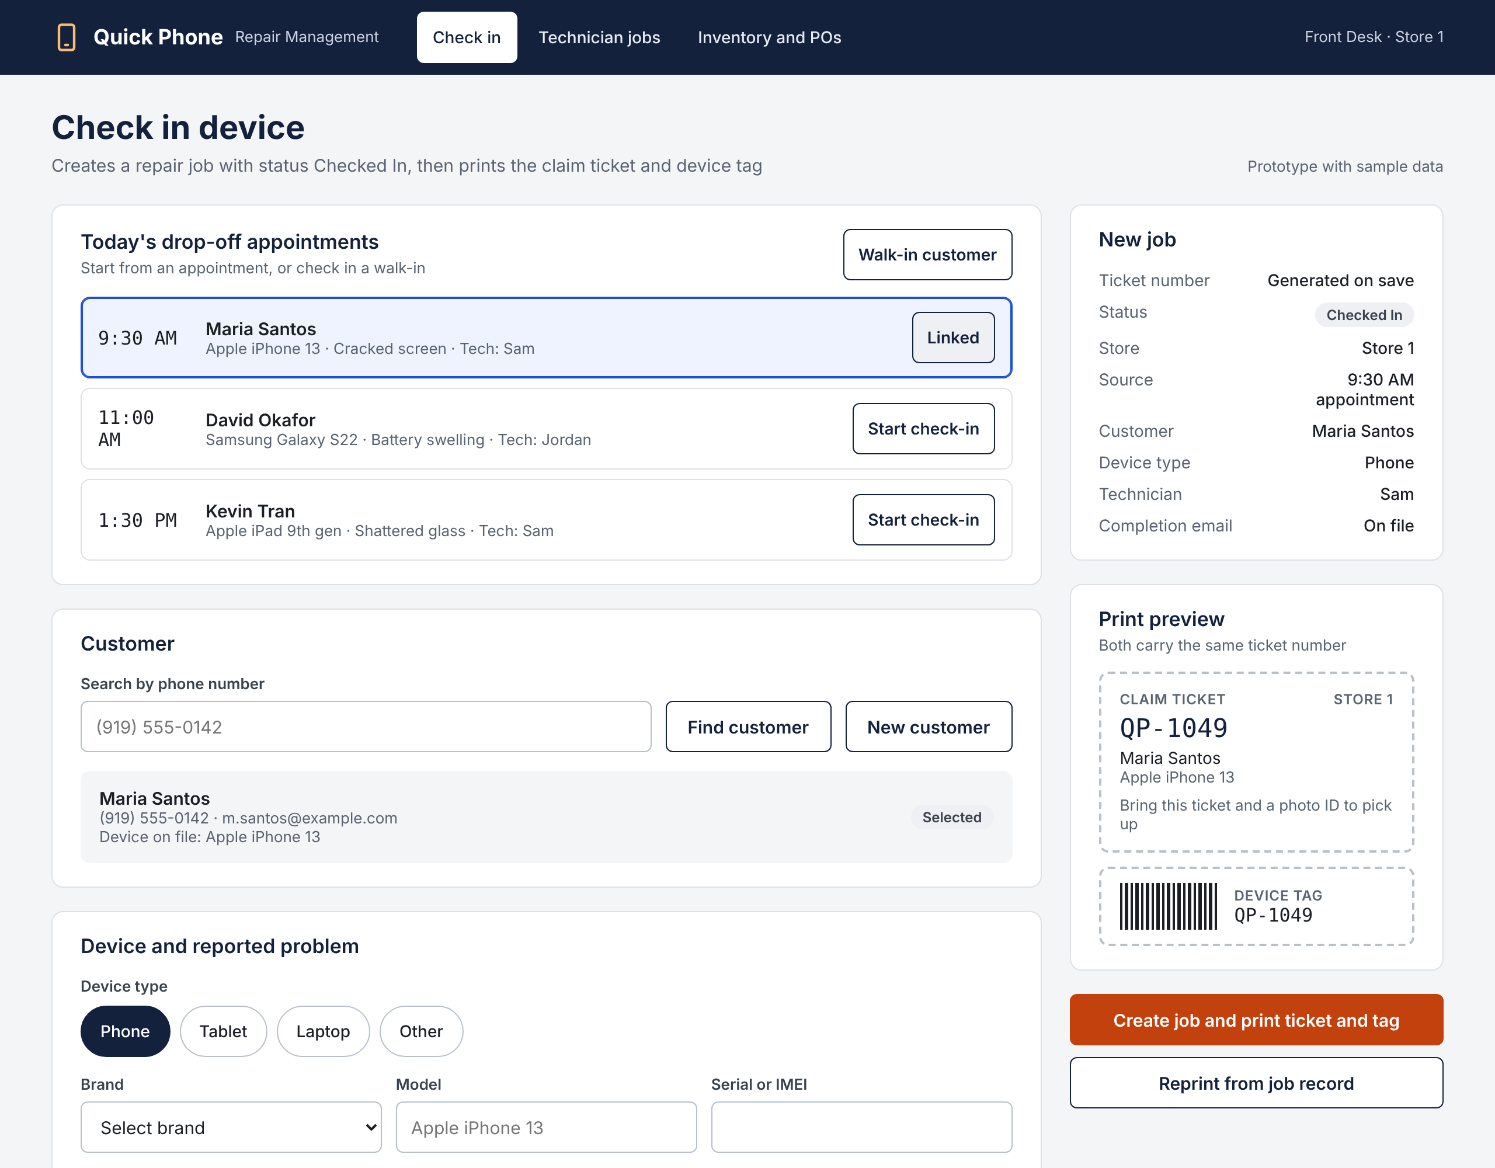
Check In Device
INTERFACE 1 · FRONT DESK
Starts from a booked appointment or a walk-in, then searches by phone so a returning customer is not entered twice
Records device, serial or IMEI, condition and reported problem, then assigns a technician by open workload
Creates the job as Checked In and prints a matching claim ticket and device tag
Flags a customer with no email so staff call at completion (alternate flow 2a)
TRACES TO
Use case
UC-01 Check In Device
DFD process
1.0 Check In Device
Requirements
FR01, FR02, FR03, FR04, NFR03
Data stores
D1, D2, D3, D6
Quick Phone Repair Management · Sprint 3 interface prototypes · Screens use sample data
Notes:
Front Desk view for UC-01. Show how check-in can start from a booked appointment (FR01, FR02) or a walk-in. Phone search comes first so we do not create duplicate customers. The technician picker shows open jobs per tech to support FR04. On save the job is created as Checked In and the claim ticket and device tag print with the same number (FR03). Mention the no-email flag, which covers alternate flow 2a.

Slide 10
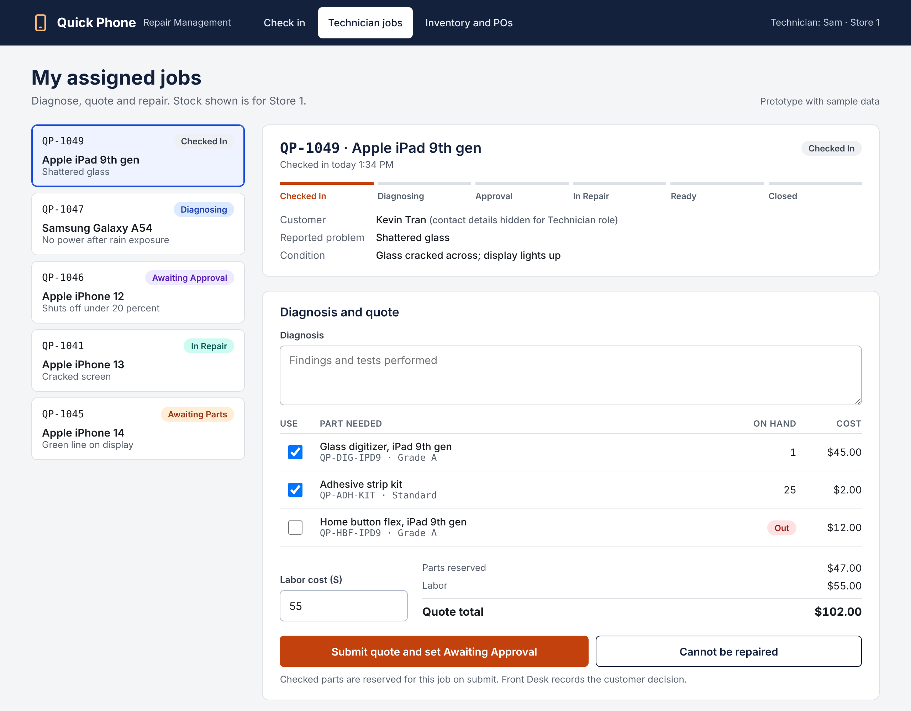
Diagnose, Quote and Repair
INTERFACE 2 · TECHNICIAN
Shows only jobs assigned to the signed-in technician, using the confirmed job statuses
Technician picks parts against live store stock and the quote totals automatically
An out-of-stock part moves the job to Awaiting Parts and adds it to the low-stock list (alternate flow 3a)
Repair view records parts used and deducts stock; customer contact and email are hidden from this role
TRACES TO
Use cases
UC-02, UC-04
DFD process
2.0 Diagnose, 3.0 Repair
Requirements
FR04 to FR07, NFR01, NFR02, NFR04
Data stores
D2, D4
Quick Phone Repair Management · Sprint 3 interface prototypes · Screens use sample data
Notes:
Technician view for UC-02 and UC-04. The left list is the assigned job queue from FR04. The selected job is in diagnosis: the tech checks the parts needed, sees stock at this store, enters labor, and the system totals the quote before setting Awaiting Approval (FR05, FR07). Picking an out-of-stock part switches the job to Awaiting Parts. Once the customer approves, the same screen switches to the repair view where parts used are recorded and deducted, and entries that would take stock below zero are blocked (NFR02). Technicians cannot send customer email or see contact details (UC-05 alternate flow 1a, NFR04).

Slide 11
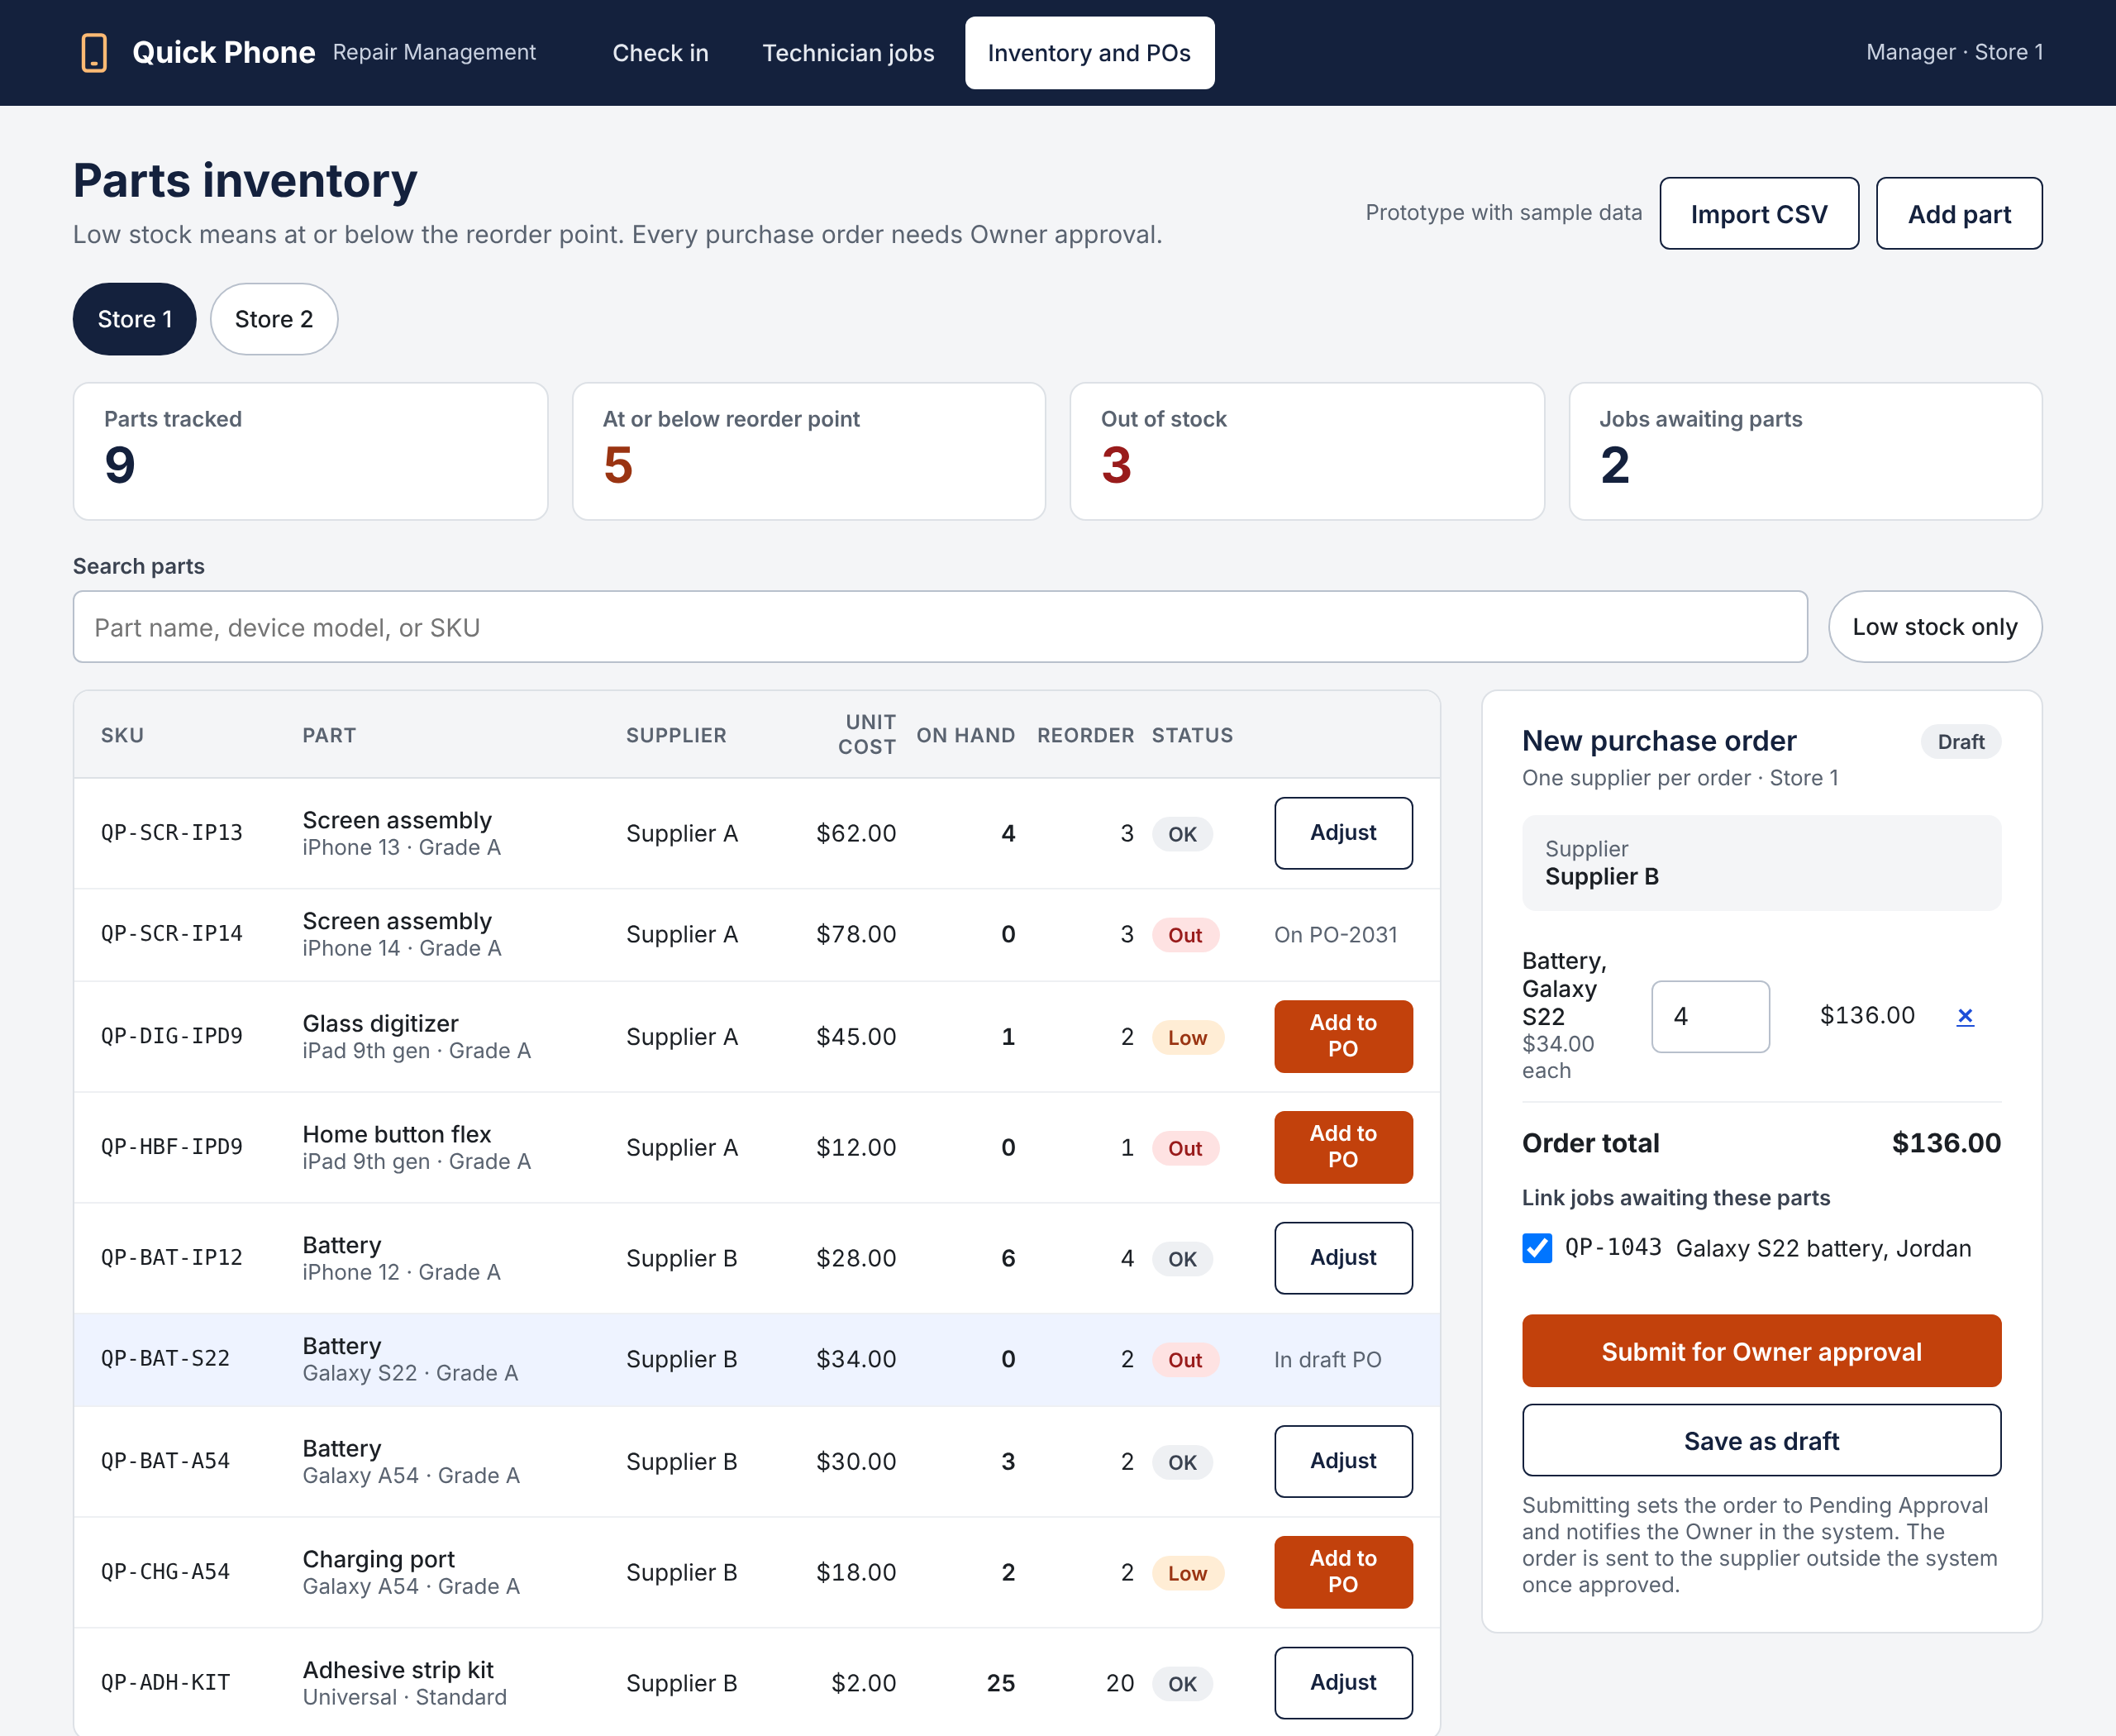
Parts Inventory and Purchase Orders
INTERFACE 3 · MANAGER
Stock for each store, with low stock defined as at or below the reorder point
Add to PO builds a one-supplier draft and links the jobs waiting on those parts
Every purchase order goes to the Owner for approval before it can be received
Receiving updates stock, supports partial delivery and returns linked jobs to In Repair
TRACES TO
Use cases
UC-07, UC-08, UC-10
DFD process
6.1, 6.2, 6.5 Replenish Parts
Requirements
FR09, FR10, FR11, NFR01, NFR02
Data stores
D2, D4, D5
Quick Phone Repair Management · Sprint 3 interface prototypes · Screens use sample data
Notes:
Manager view for UC-07, UC-08 and UC-10, matching Level 1 process 6.0. The tiles and the Low status use the reorder point rule from UC-07, and Import CSV covers FR11. Add to PO starts a draft for one supplier and links jobs that are Awaiting Parts (UC-08 step 3). Submitting sets Pending Approval for the Owner (UC-09). Receiving is only allowed on an approved order, handles partial delivery, and moves linked jobs back to In Repair (UC-10).

Slide 12
Limitations, risks and decisions needed
Limitations
Store equipment and connectivity are unconfirmed
Use cases not yet walked through with the owner
Technology chosen provisionally; the owner’s support answer can reverse it
Prototype slides still cite Sprint 2 DFD numbers
Risks
No one named to support the system after the December 9 handoff
Every purchase order waits on the owner's approval
Staff may skip new check-in and release steps when the counter is busy
Models are AI-assisted; every member must be able to explain them
Decisions needed
Owner: staff-sent or automatic pickup notification email (FR12)
Owner: a PO spending threshold or urgent path (FR10)
Owner: does a Manager cover one store or both?
Professor: are nine Level 0 processes and the derived physical columns acceptable?
Notes:
Now our reflection, starting with what is still open. Limitations: we have not confirmed the equipment and internet connection at each store, we have not yet walked the owner through the use cases step by step, the technology choice in our alternative matrix is provisional until the owner tells us who will support the system, and the prototype slides you just saw still cite the Sprint 2 process numbers. We will update them. Risks: the biggest is that nobody is named to support the system after we hand it over on December 9, which is also the largest unknown in the yearly cost. Every purchase order waits on the owner, so orders could stall when the owner is busy. Staff may skip the new check-in and release steps on a busy day. And our models were built with AI help, so each of us has to be able to explain them. Decisions needed: the owner has to choose whether staff send the pickup notification or the system sends it automatically, whether purchase orders need a spending threshold or an urgent path, and whether a manager covers one store or both. From you, we would like feedback on two modelling choices: keeping nine processes on Level 0, and storing derived columns in the physical ERD.

Slide 13
Uncertainty and next steps
Uncertainty
Benefits are estimates: about 6 staff hours a week, $8,952 a year and a $17,100 three-year NPV (likely case)
They rest on assumed volumes and national wage rates until the owner gives real baselines
Django and PostgreSQL chosen provisionally; the subscription wins if nobody will support the system after December 9
Free appointment times assume store hours less bookings until the owner says how availability is set
Next steps
Owner walkthrough before November 2: use cases, the three interface alternatives, equipment and open rules
Settle FR10, FR12 and Manager scope; update the catalog, use cases and models, and log each change
Re-score the alternative matrix with the owner’s answers
Update prototype traces to the Sprint 3 DFD numbering
Team walkthrough of the DFDs and ERD; decide the pending AI log rows
Start the Sprint 4 build and specification
Notes:
Uncertainty and next steps. Our benefit figures are estimates: about six staff hours a week, roughly 8,952 dollars a year, and a three-year net present value of about 17,100 dollars in the likely case. They rest on assumed repair volumes and national wage rates, and they will change once the owner gives us real numbers. The technology is chosen only provisionally: a custom Django and PostgreSQL web app scored highest in our alternative matrix, but if the owner cannot name anyone to support it after December 9, a repair-shop subscription comes out ahead. And free appointment times assume store hours minus existing bookings until the owner tells us how availability is really set. Next steps: we will walk the owner through the use cases, the three interface alternatives, the equipment and the open business rules before November 2. Their answers will settle FR10, FR12 and the manager question, and we will update the catalog, use cases and models and log each change. We will re-score the alternative matrix with the owner’s answers, update the prototype traces, walk the whole team through the DFDs and ERD, and then start the Sprint 4 build and specification.

Slide 14
Thank you
Notes:
Thank you. To sum up: the models now answer your Sprint 2 feedback and match the textbook, and our main open items are the owner's decisions and the walkthrough before November 2. We would welcome your feedback on the nine-process Level 0 and the derived physical columns, and we are happy to take questions. Every AI contribution is in our AI Decision Log, and any of us can walk you through a model or a decision.

